Slide 1

Emergency Alert and assessment for training purposes
Chaoui, Nada
Rosario, Reynaldo

Slide 2
Preview
FEMA – Disaster Assistance
Goal and Objective
Software tools
Modeling

Slide 3
FEMA – Disaster Assistance
FEMA -The Federal Emergency Management Agency- coordinates the federal government's role:
Prepare for
Protect against
respond to
recover from
Response to hurricanes, earthquakes, floods and other natural disasters.
Notes:
FEMA (Federal Emergency Management Agency) is an agency that supports the citizens and first responders to prepare for, protect against, respond to, recover from, and mitigate all hazards
FEMA is committed to protecting and serving the American people mainly in response to hurricanes, earthquakes, floods and other natural disasters.

Slide 4
Goals/Objectives
The logistics that FEMA goes through at an emergency alert of a disaster; receiving, storing and shipping
Simulation of an emergency alert of a disaster; receiving, storing and shipping
Training Assessment
Our goal is to provide a virtual environment that corresponds to FEMA’s requirements and needs to train their employees virtually.
The use of a virtual environment will help them train their employees before they go on site which will save them time and money.
Notes:
As FEMA’s warehouse facility is far from their assistance offices, we are proposing to provide them with a virtual environment to train their new hires before they go on site.

Slide 5
Software Tools
Google Sketchup
Vizard

Slide 6
Modeling
a warehouse building
parking space
grass
Sky
people
trucks
trailers
mobile office
computers
equipment
tents
cargo plane
portable restrooms
houses
ramps
yellow cones

Slide 7
Modeling
Lights
Timers
Keyboard functionalities
Avatar Animation
Audio file

Slide 8
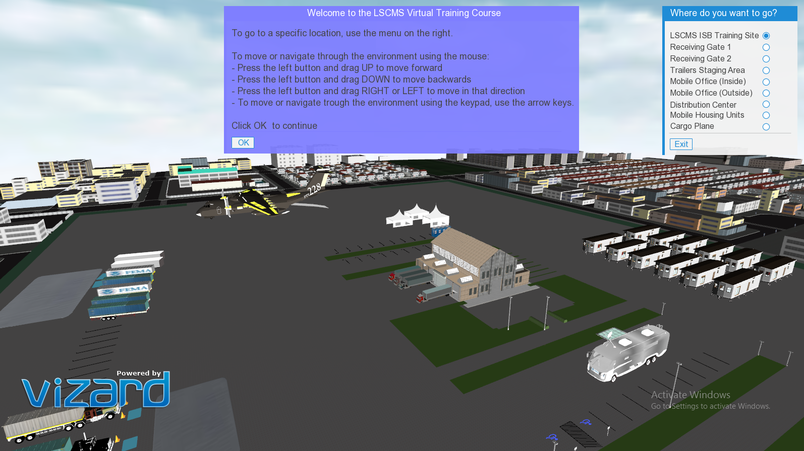
Bird view of our environment

Slide 9
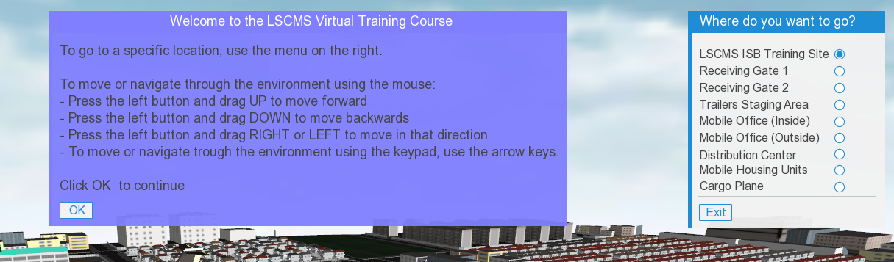
directory panel while running the application

Slide 10
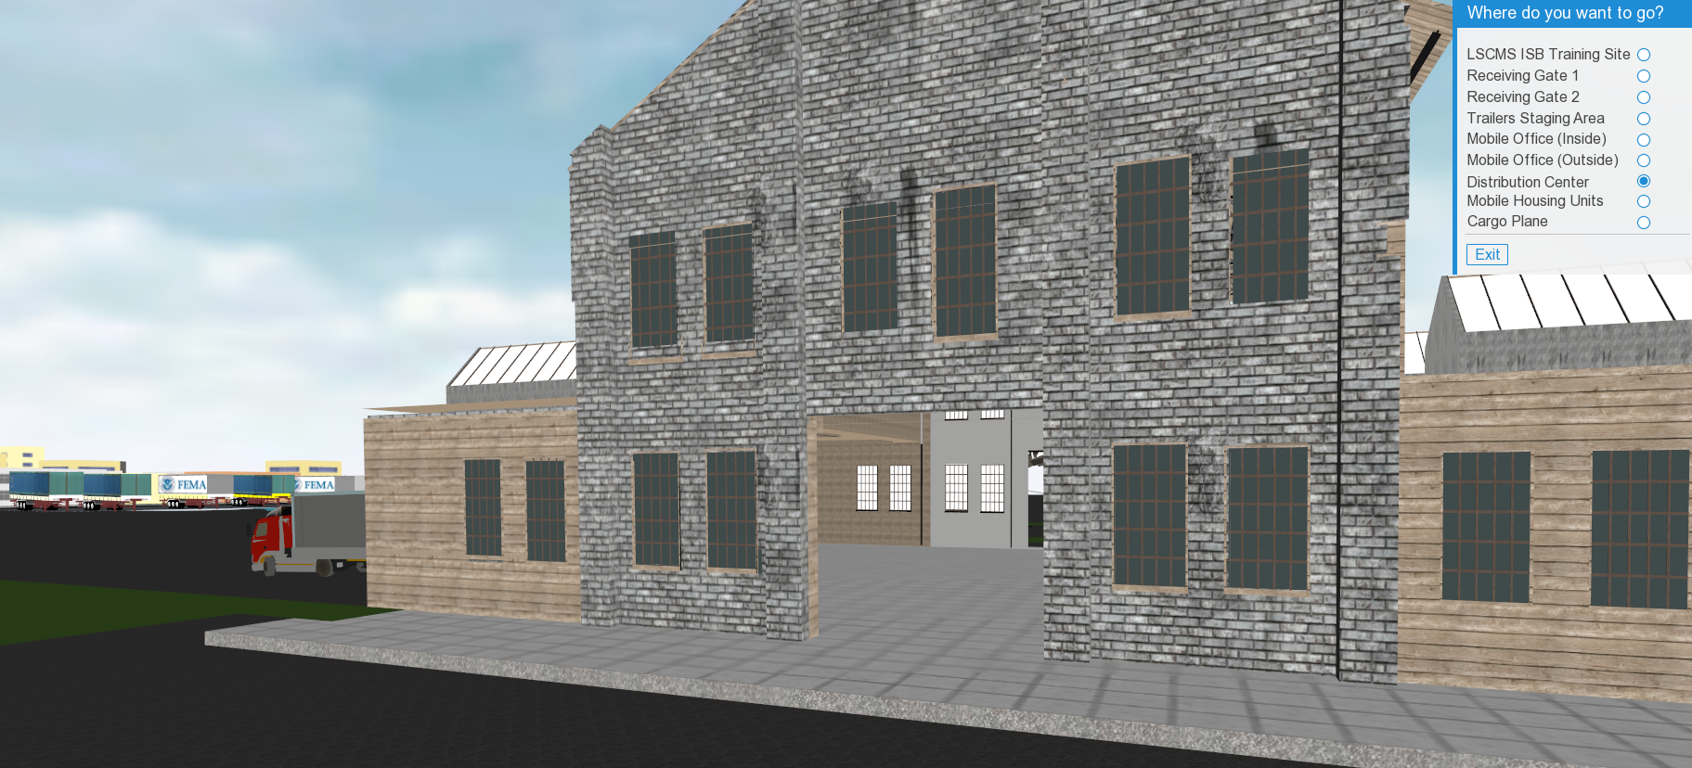
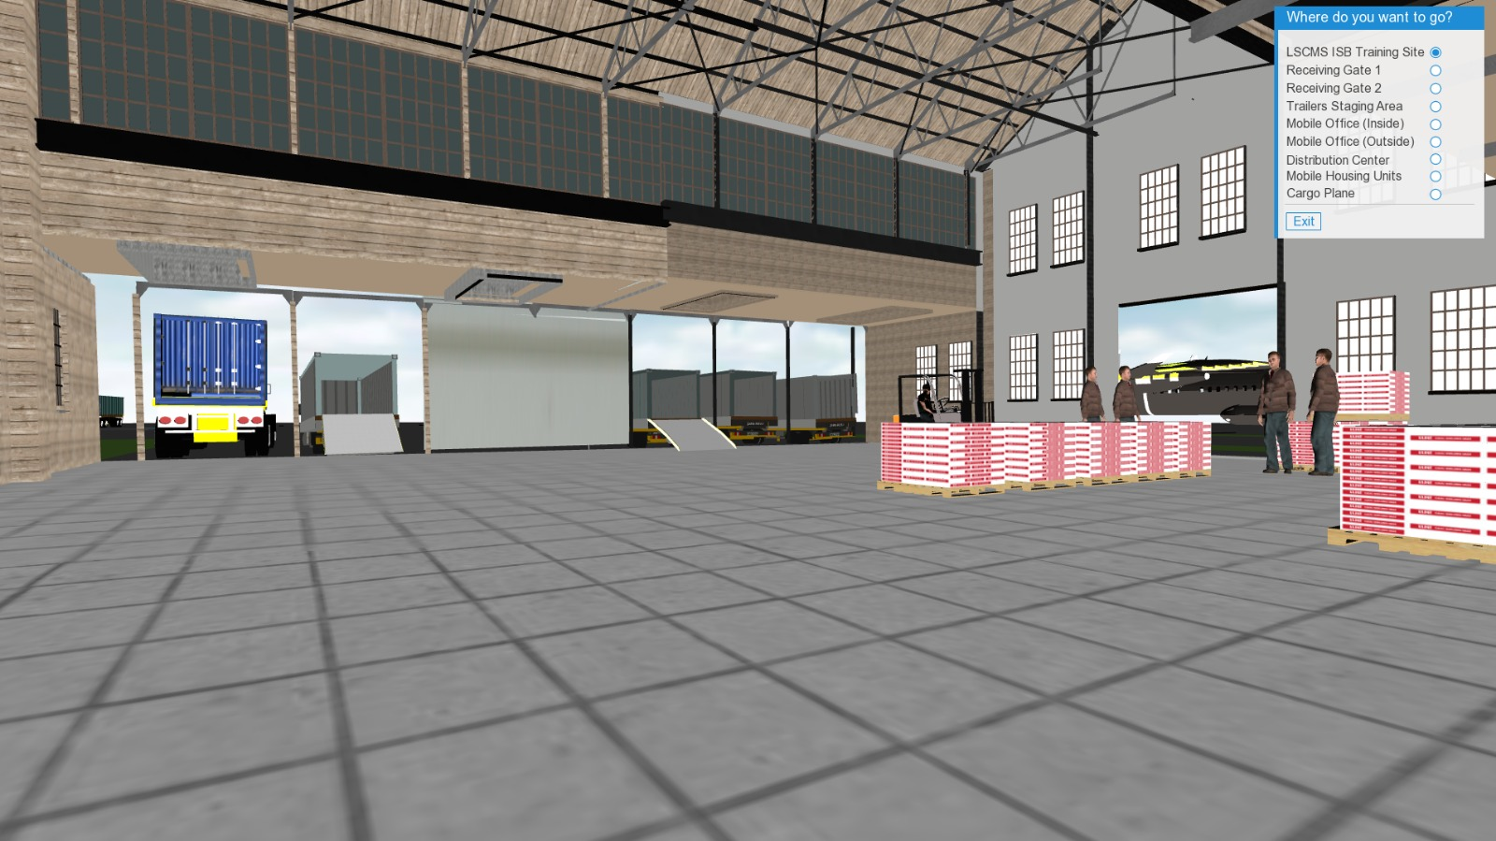
The front of the warehouse
The inside of the warehouse

Slide 11
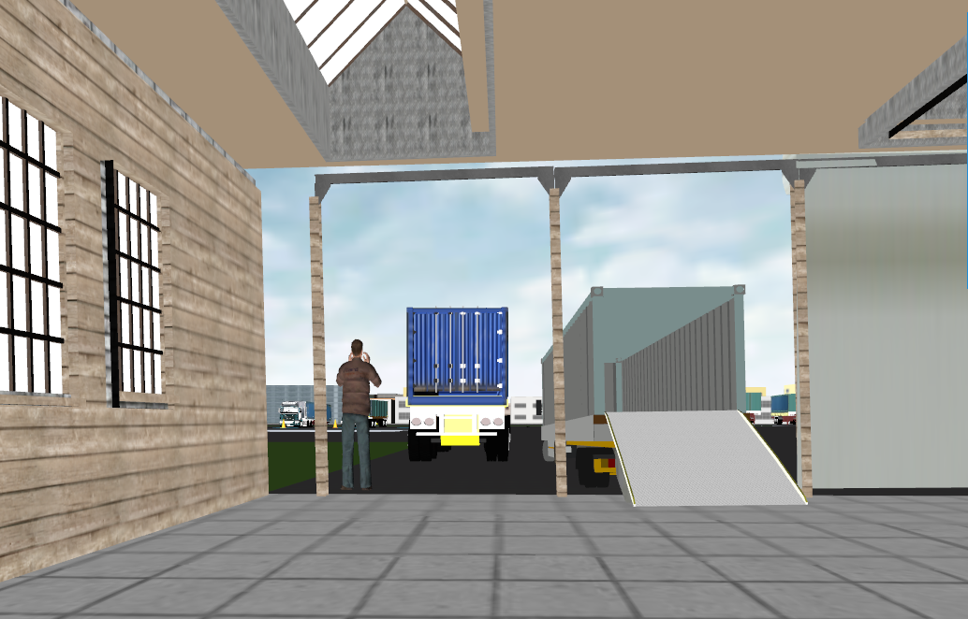
An employee directing the car while parking

Slide 12
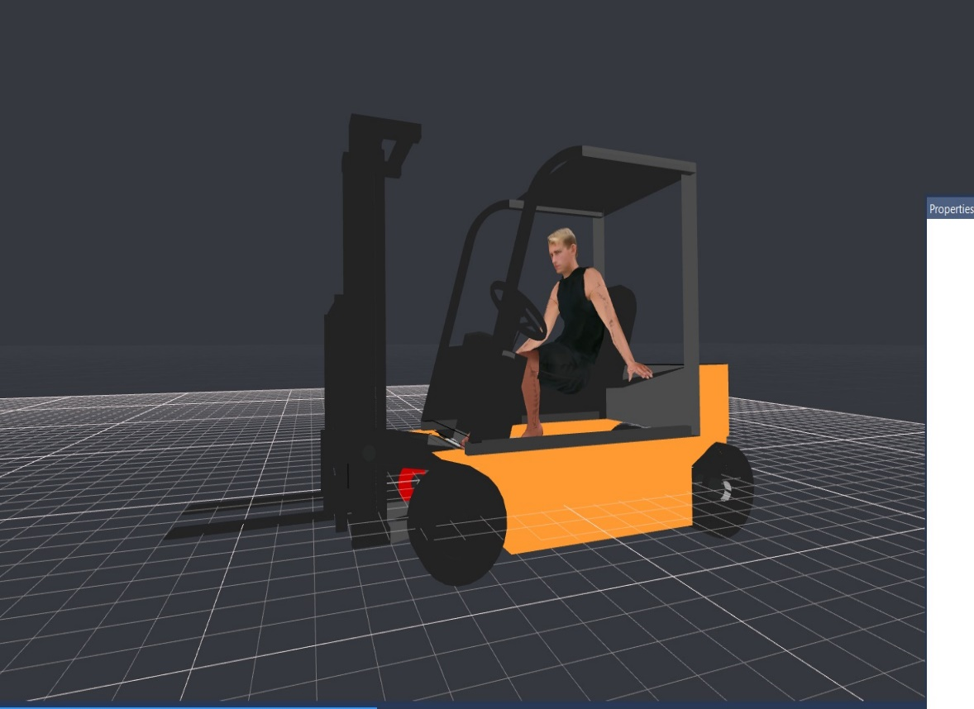
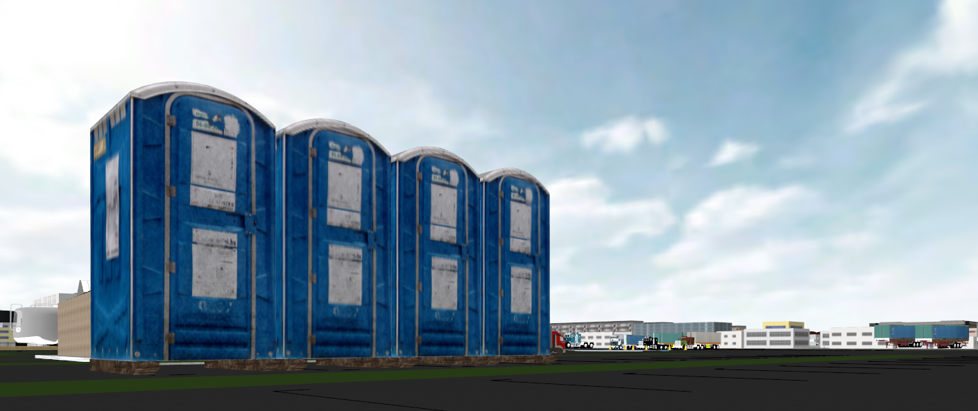
Fork lift used inside the Warehouse
Portable Restrooms

Slide 13
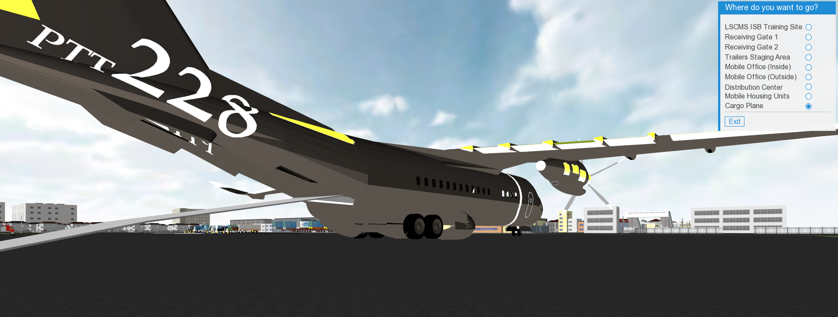
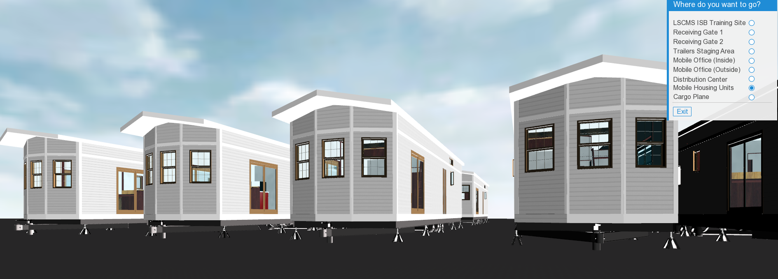
Cargo Airplane
Mobile Housing Unit

Slide 14
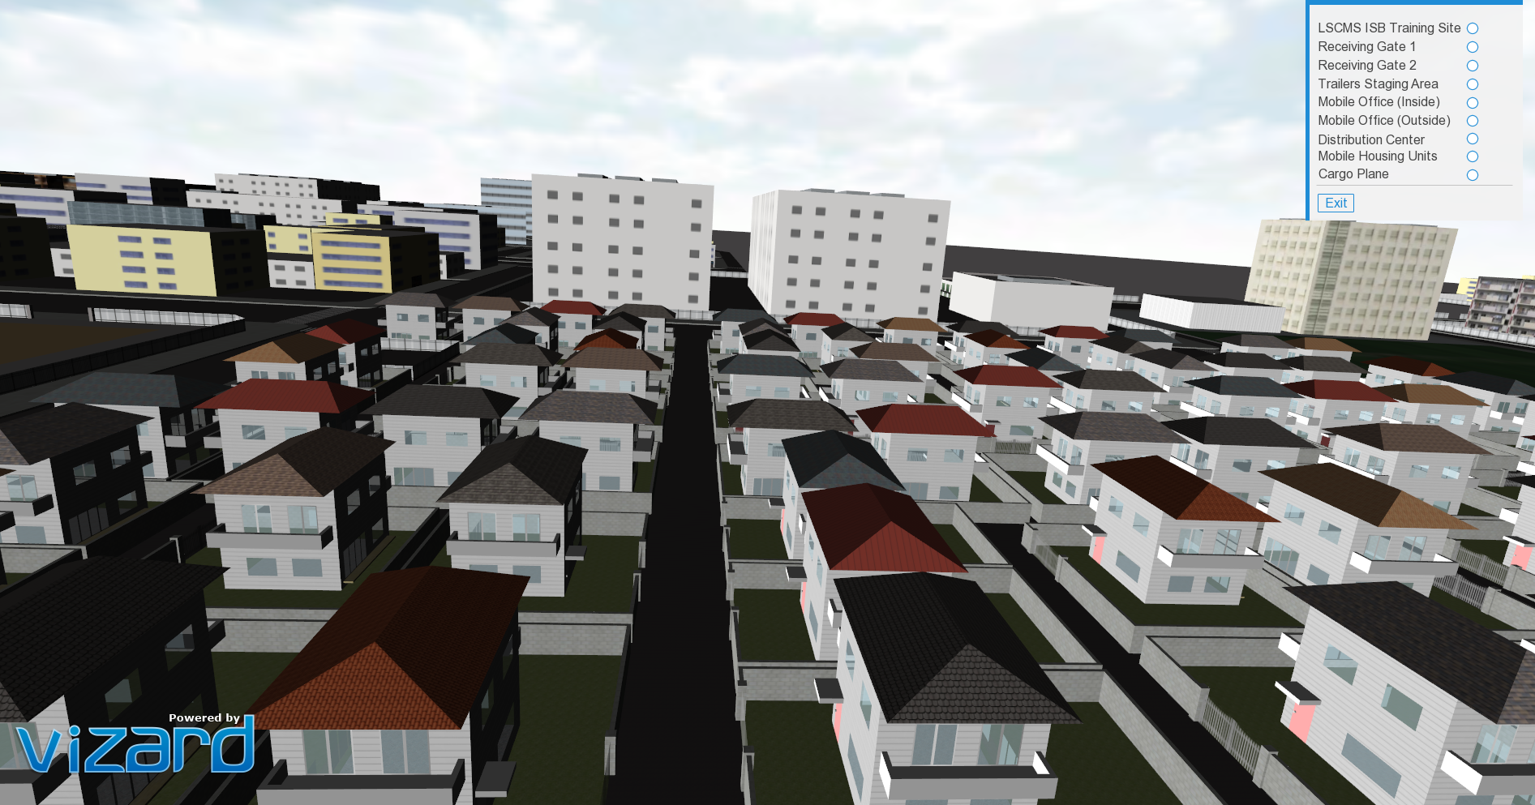
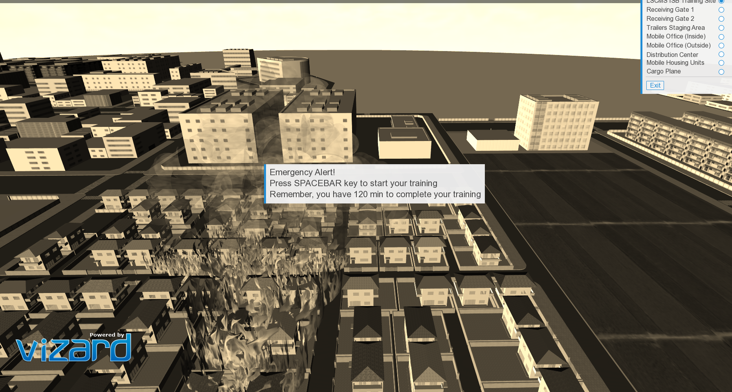
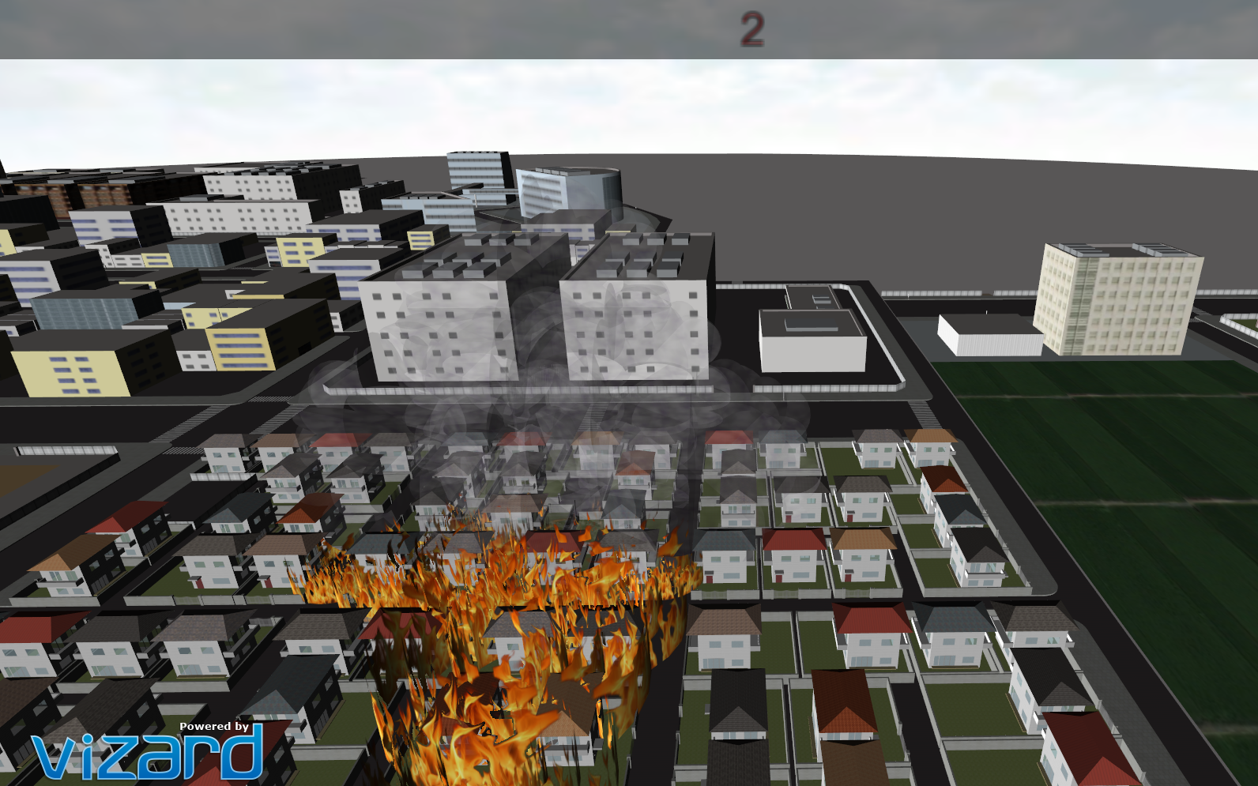
The simulation of the fire:
Picture Before the Fire
When the simulation starts, the shade of the screen changes to sepia and the timer starts

Slide 15
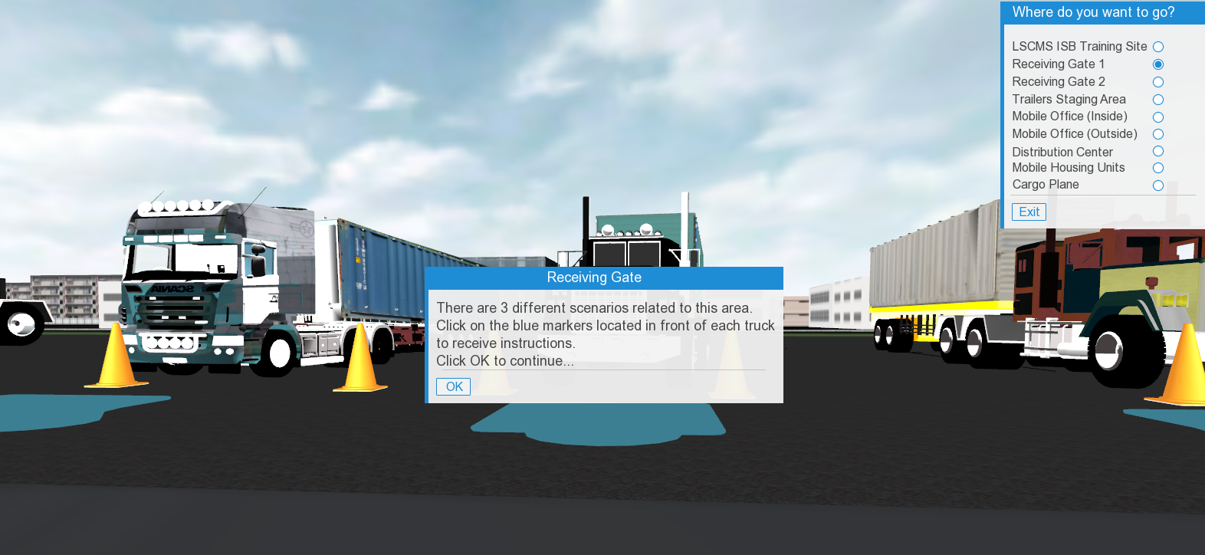
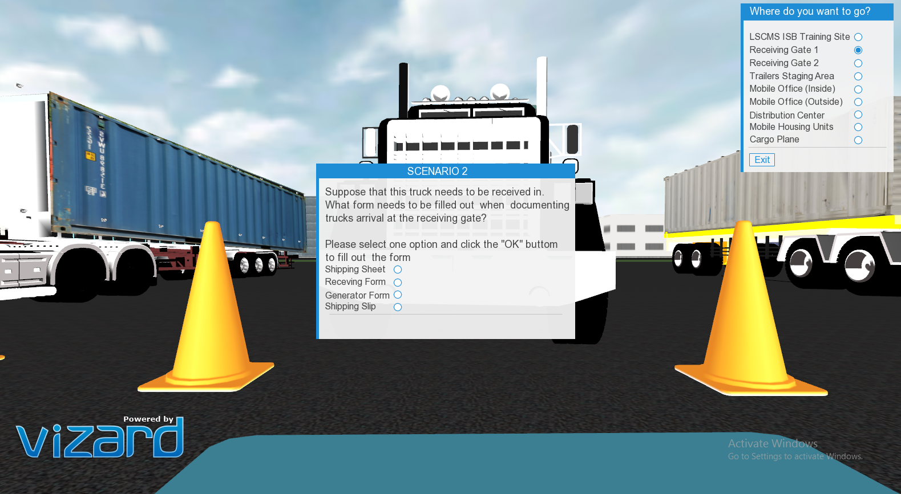
Receiving Gate 1 Training info panel
Receiving gate1 pop up question panel

Slide 16
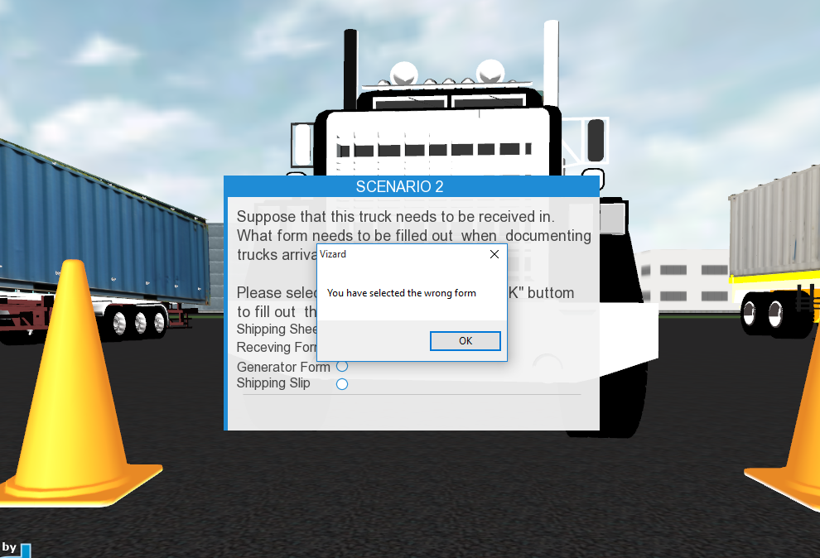
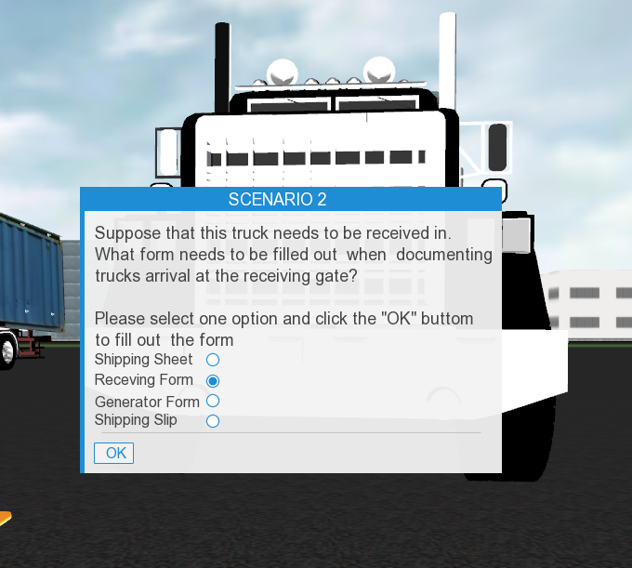
Pop up error message in case of selecting the wrong answer
The OK button appears when the user selects the correct answer

Slide 17
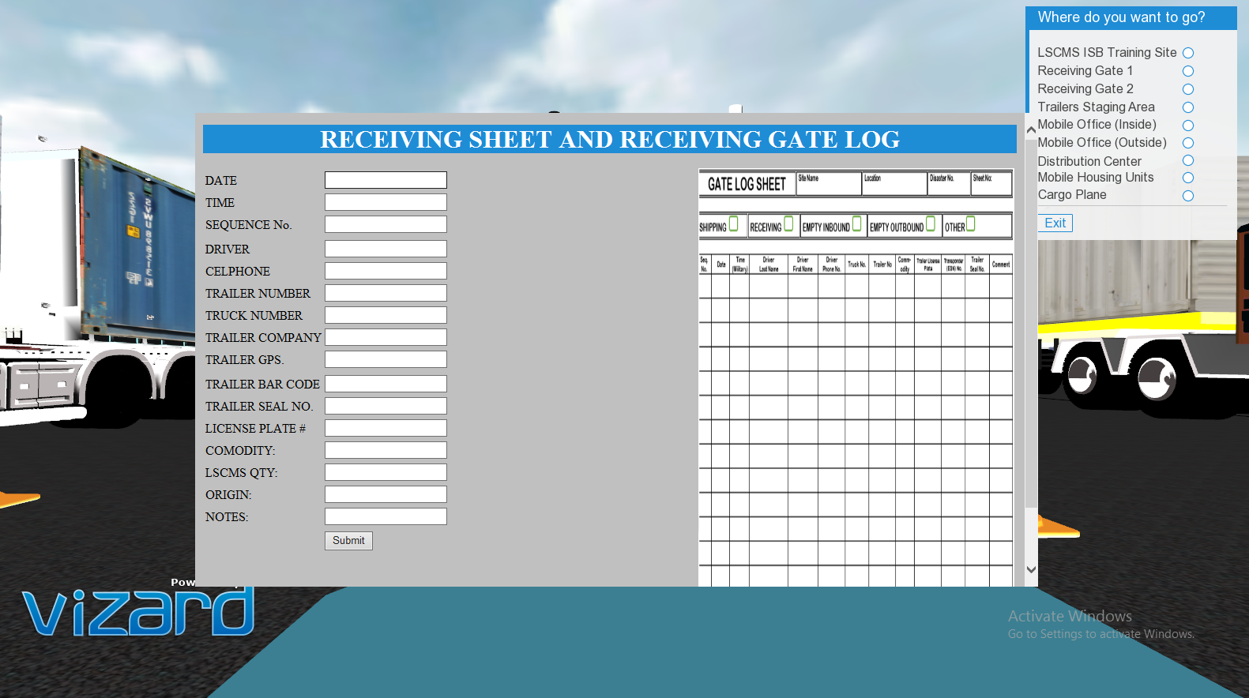
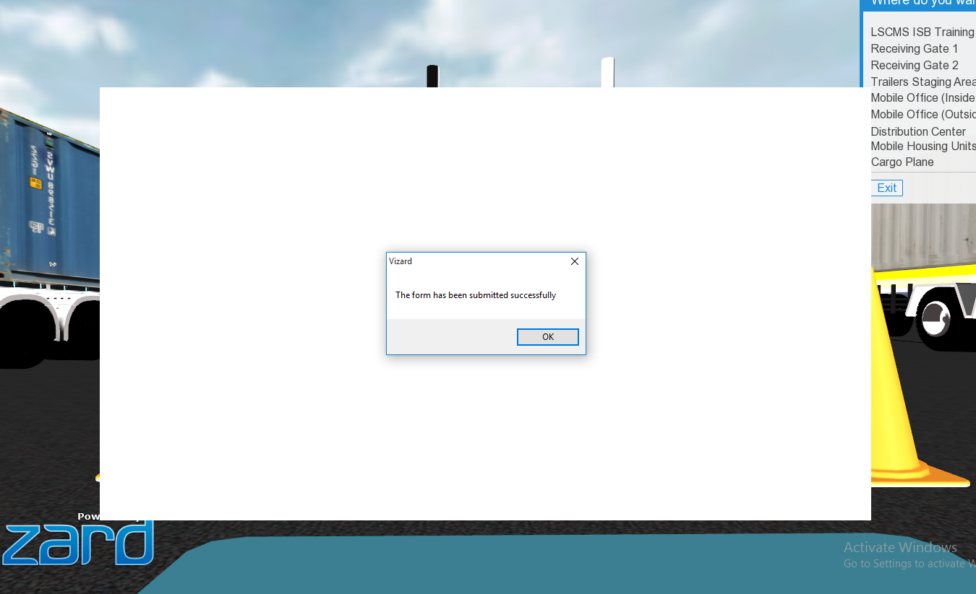
Receiving gate html form
Confirmation pop up when submitting the form

Slide 18
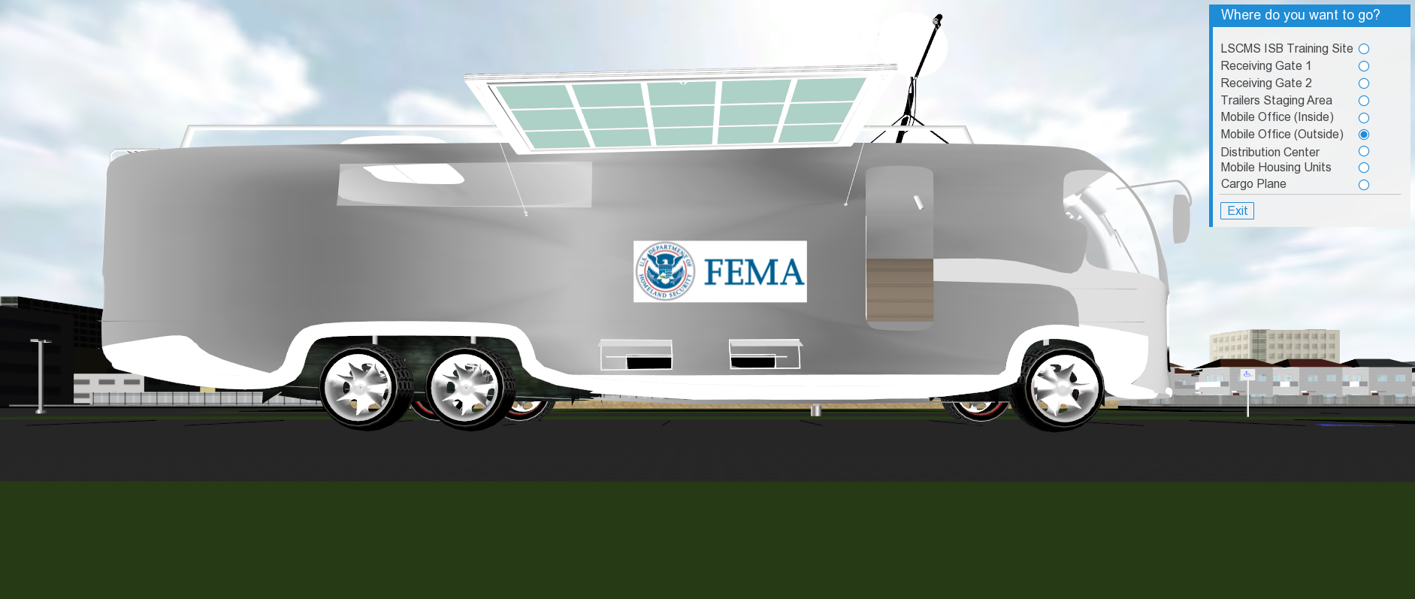
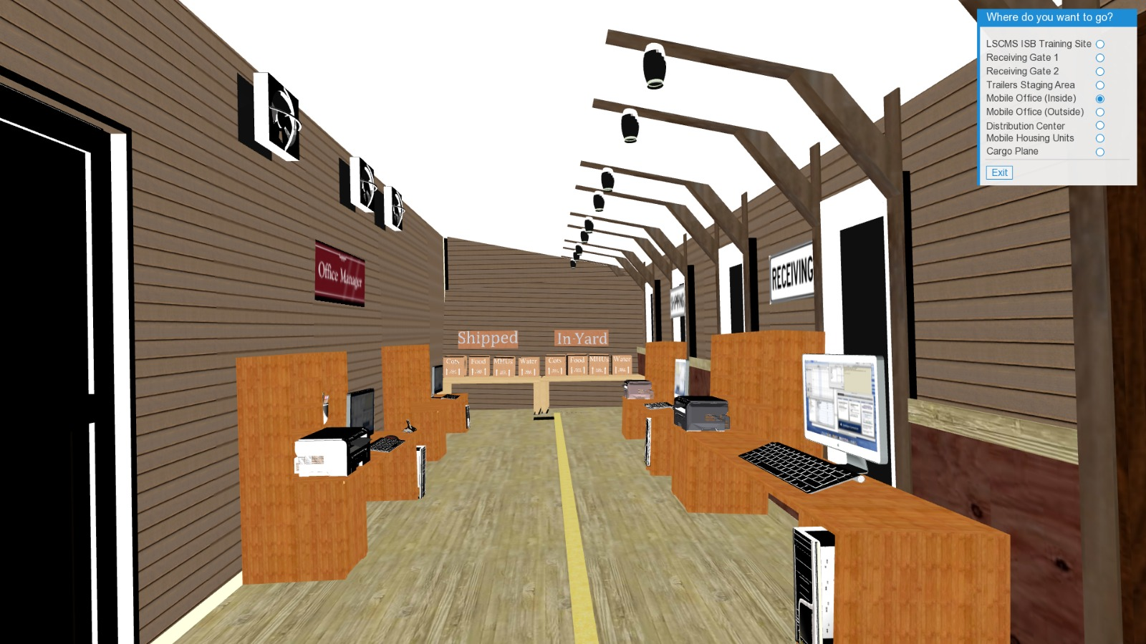
Mobile Office - outside
Mobile Office - inside

Slide 19
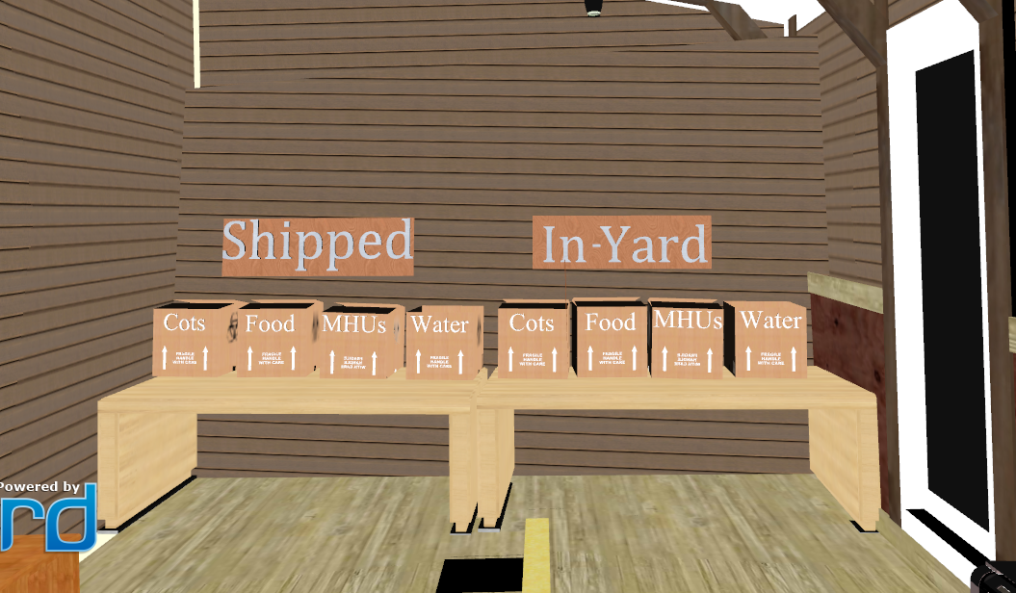
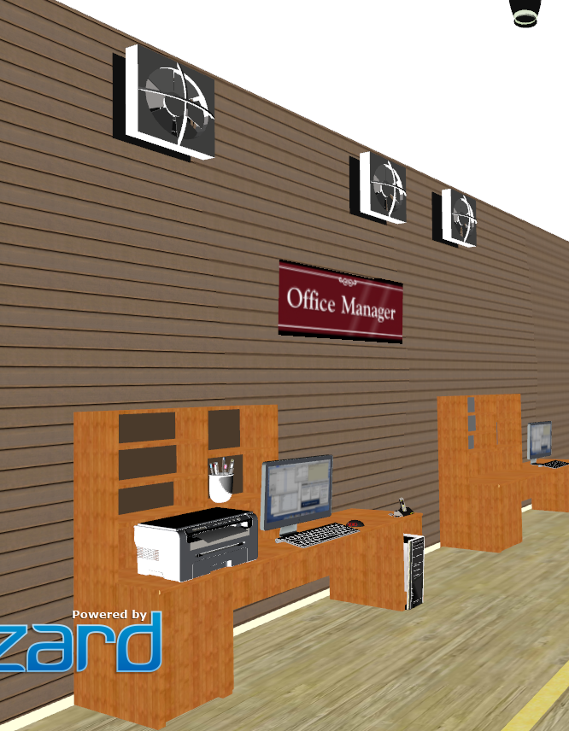
The inside of the Mobile Office details

Slide 20
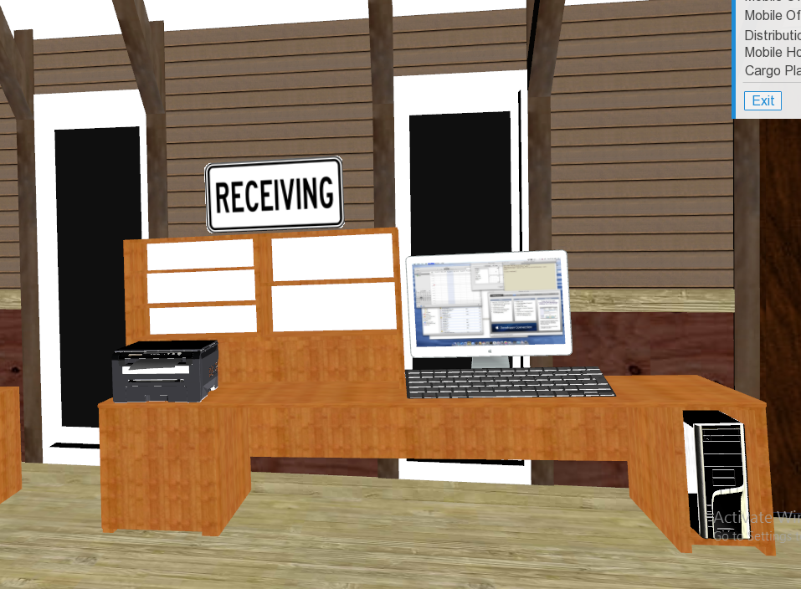
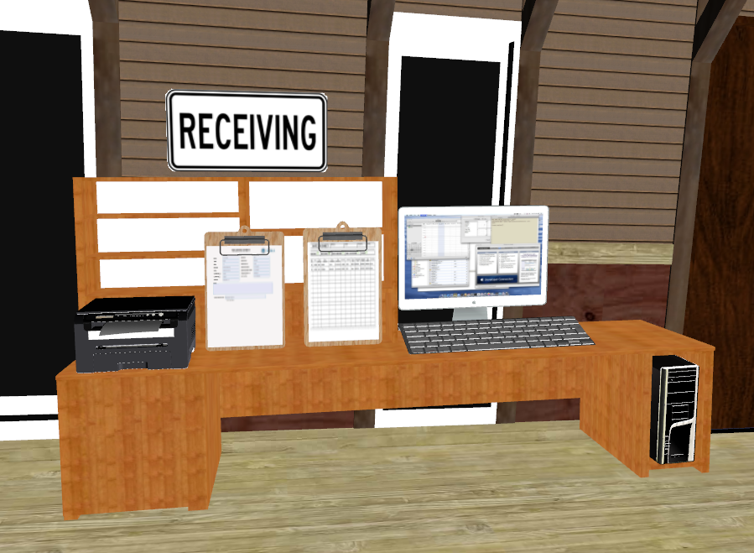
The inside of the office at the Receiving view before the submission of the form
The inside of the office at the Receiving view after the submission of the form

Slide 21
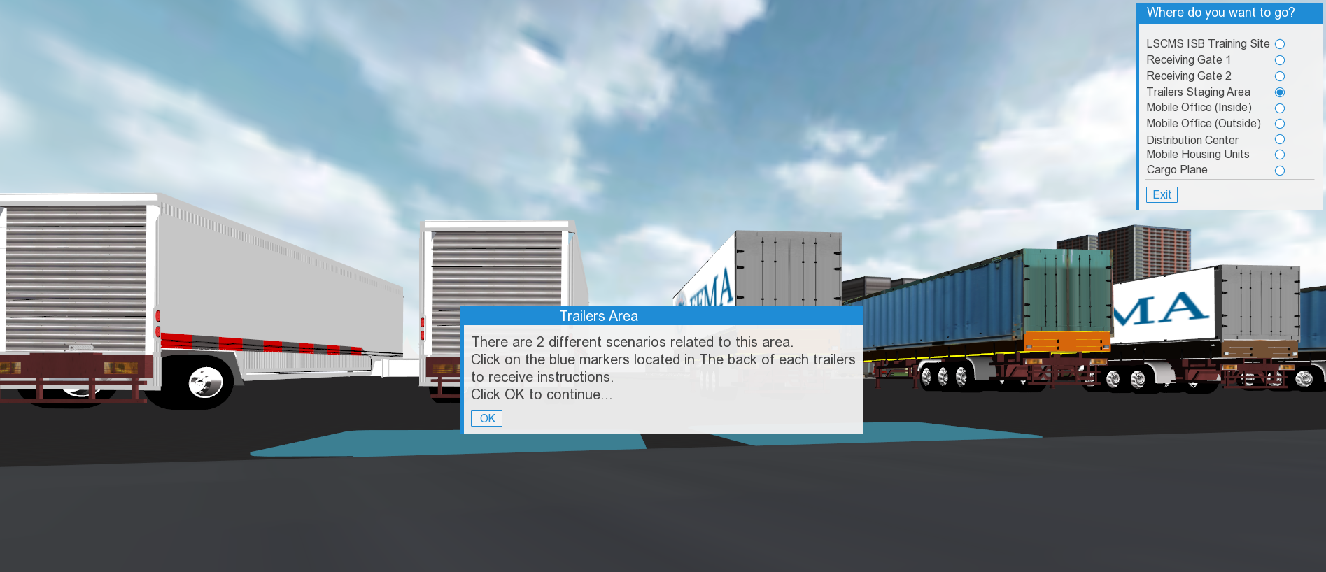
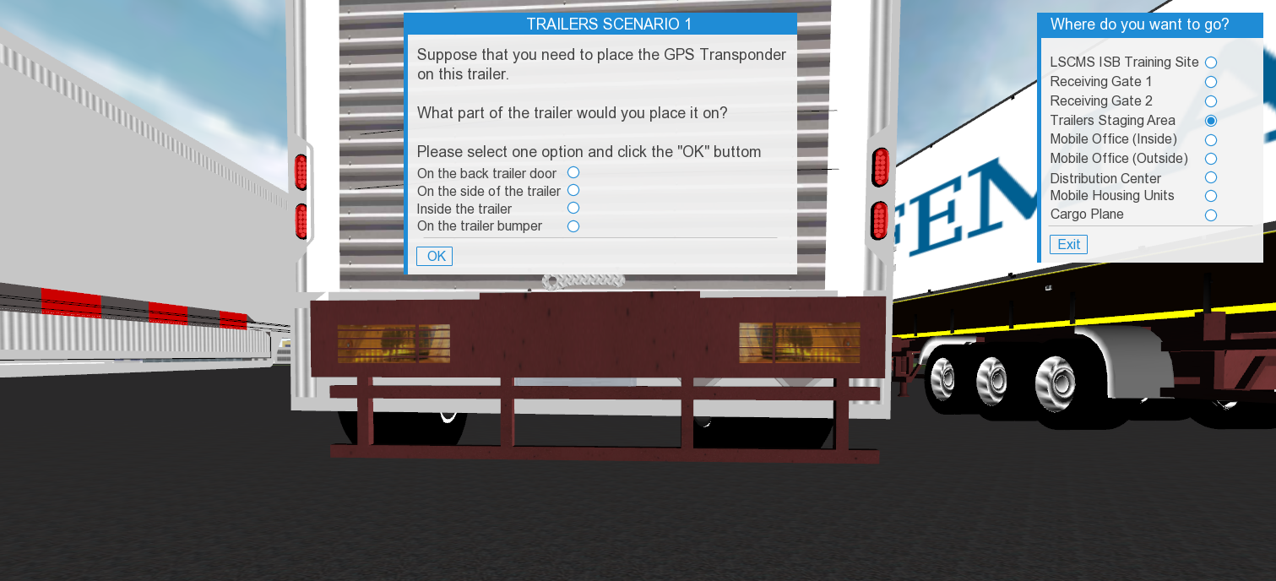
Info panel message at the back of the trailers area
Info panel message at the back of the trailers area that tests the trainee

Slide 22
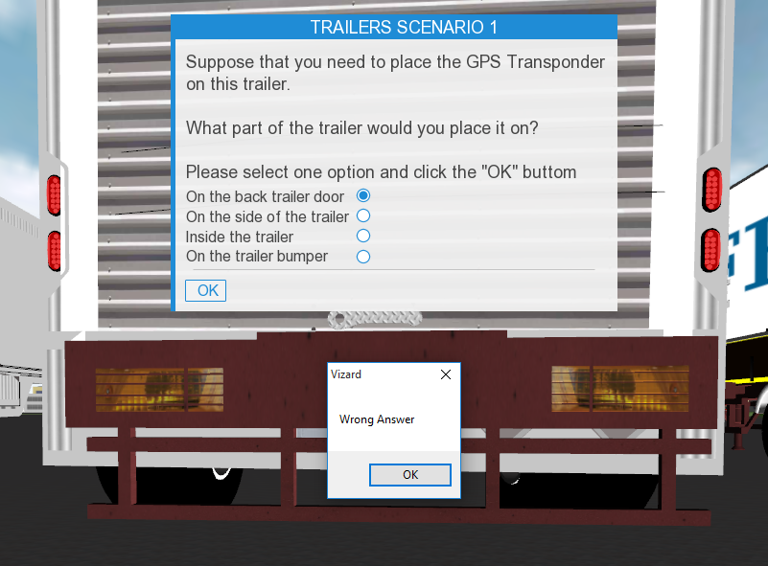
Pop up error message at the back of the trailers area when selecting the wrong answer

Slide 23
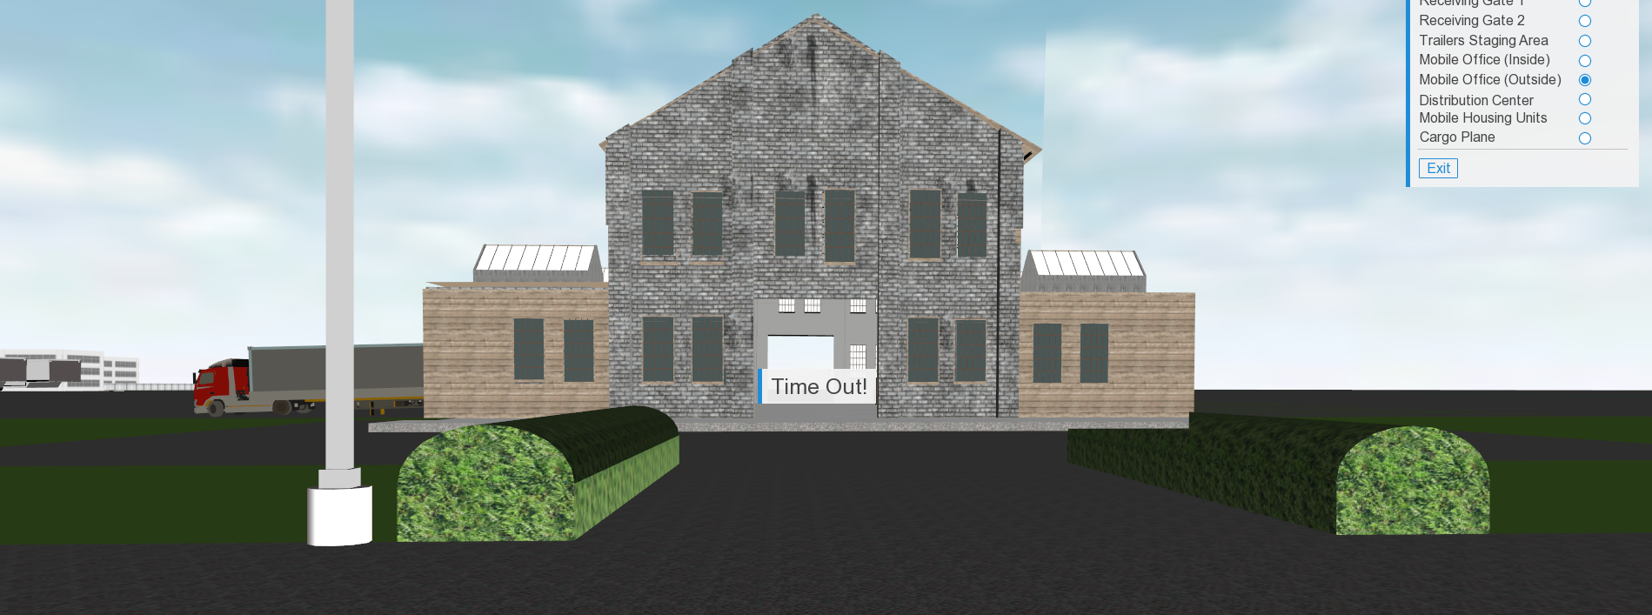
Time Out info panel message when the timer is over

Slide 24
Thank you

